Slide 1
Columbia and TMA-Brazil
Restructuring Conference
Fall 2025

Slide 2




Panelists
Philip Abelson
White & Case
Gilberto Gornati
TWK Advogados
Rachel Strickland
Fried Frank
Patricia Tomasco
Quinn Emanuel

Slide 3
Policy/Goals of Chapter 11
Reorganization Policy
  Encourage reorganization rather than liquidation
Equity Policy
  Provide similar treatment to similarly situated parties
Discharge/Fresh Start Policy
  Discharge of prepetition debt
  Only continuing obligations set forth in plan

Slide 4
Key Elements of the
Chapter 11 Process

Slide 5
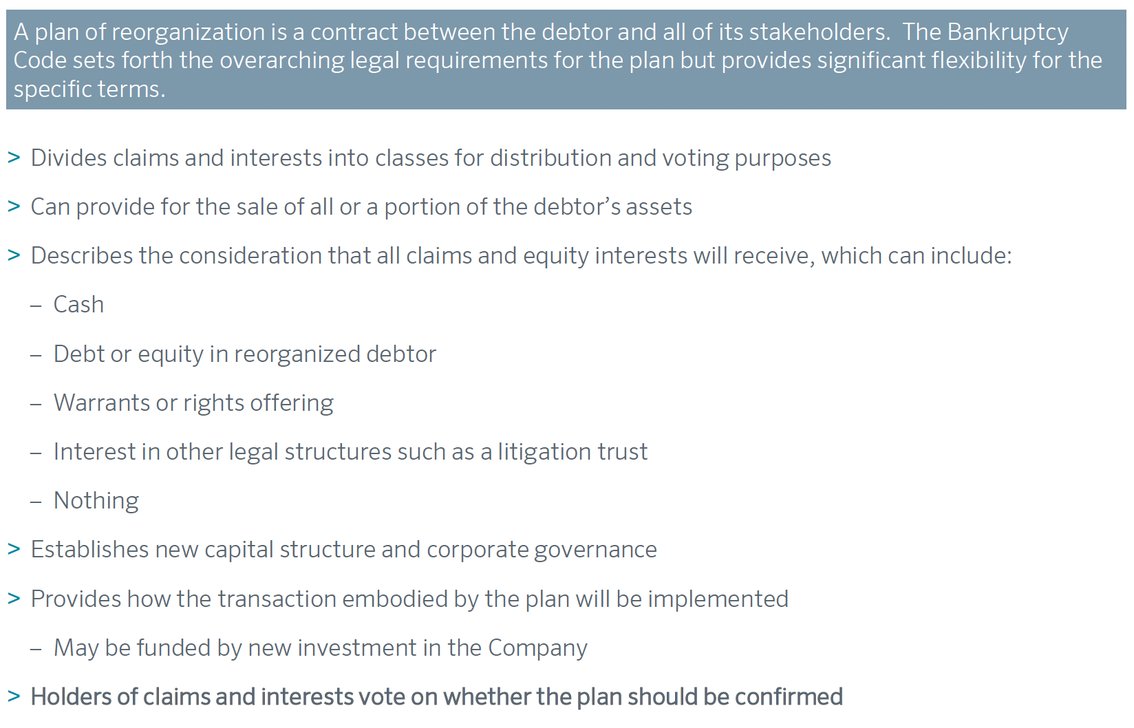
The Plan

Slide 6
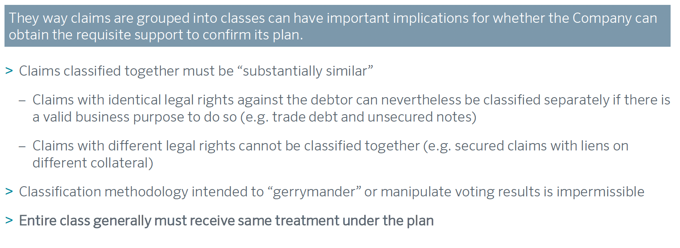
Classification

Slide 7
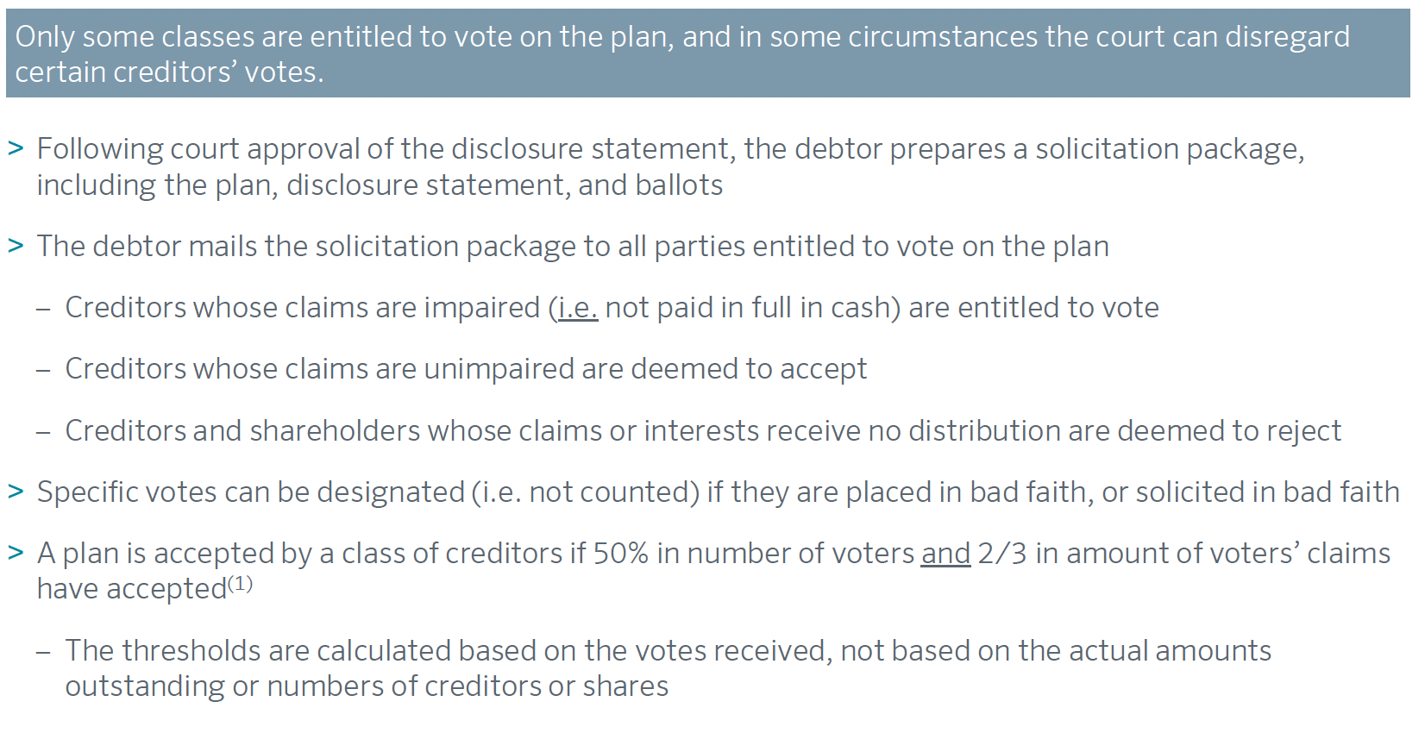
Voting

Slide 8
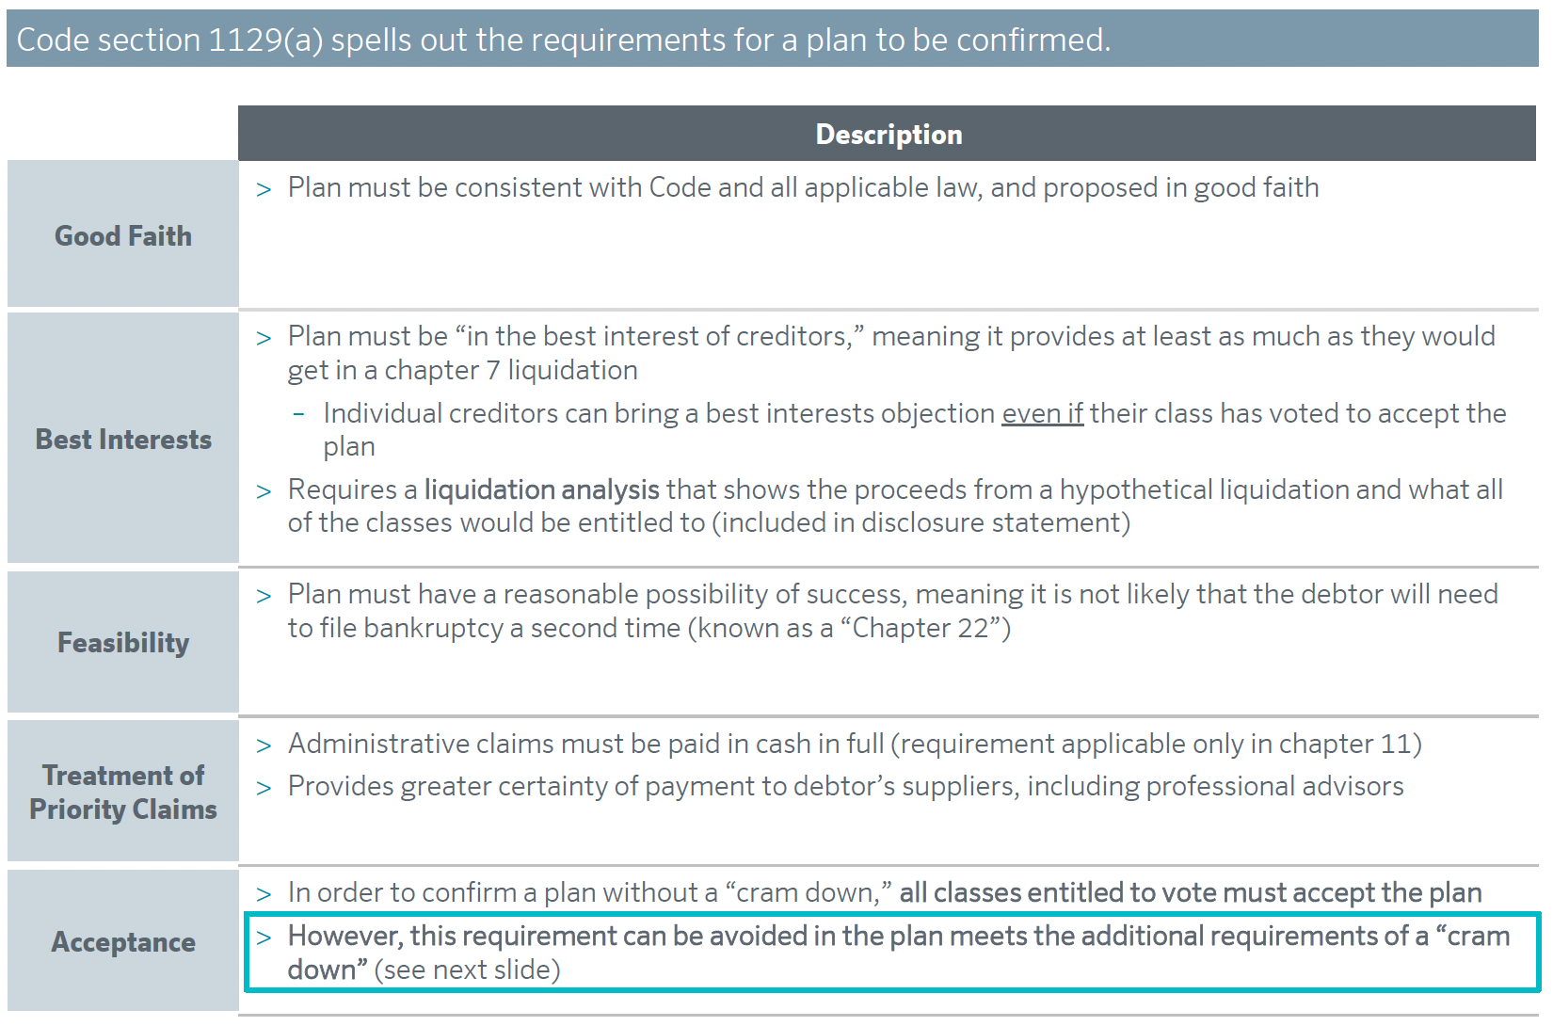
Confirmation

Slide 9
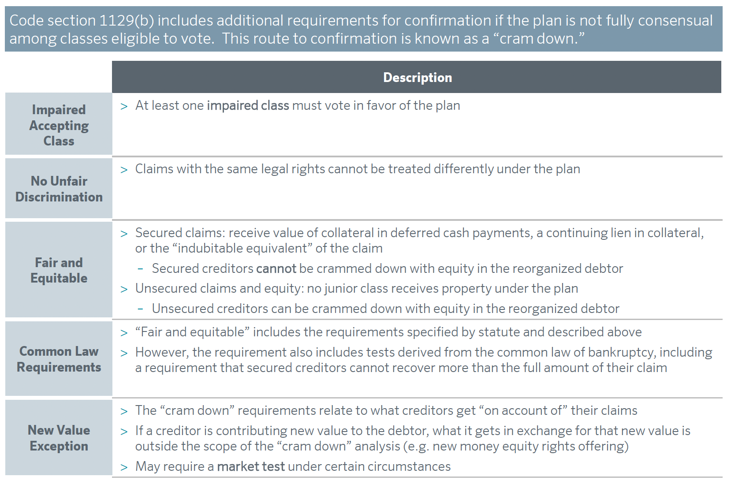
Cramdown

Slide 10
Frictions in the
Chapter 11 Process

Slide 11
Frictions
Professional and other fees
Claims trading and deal instability
Valuation disputes
Competing plans
Limits on gifting and other deals to simplify and speed up the process

Slide 12
Tools for Managing the
Chapter 11 Process

Slide 13
Tools for Managing the Frictions
Restructuring Support Agreements (RSAs)
Going Concern Sales (363 sales)
Third-Party Releases

Slide 14
Recent Controversies
in Chapter 11

Slide 15
Recent Controversies
How LMEs change the profile of firms filing for Chapter 11: Effects of private debt and PE sponsors
Backstop fees and equality of distribution under 1123(a)(4)
Protecting the finality of the deal: good faith purchaser protections and equitable mootness
Texas two-steps and mass torts
Double Dips
Crypto

