Slide 1
Columbia and TMA-Brazil
Restructuring Conference
Fall 2025

Slide 2



Panelists
Ronit Berkovich
Weil Gotshal
Sheila Cerezetti
Universidade de São Paulo
Edward Morrison
Columbia Law School

Slide 3
Overview of Chapter 11

Slide 4
The Goal of Chapter 11 is a Reorganization Plan
Plan is outcome of a bargaining process.
Debtor/creditors (and sometimes shareholders) bargain over …
  Should the debtor be reorganized or its assets sold?
  What debt is consistent with firm’s ability to pay
  How should existing claims be restructured in light of (i)?
    ➔ Some creditors will have claims reinstated, others will receive a cash payoff, others will receive new claims or equity interests (usually worth less than original claims), and others will receive nothing (their claims will be wiped out).
  Will shareholders retain an ownership interest, or will ownership be transferred to creditors?

Slide 5
Chapter 11 Imposes Structure on the Bargaining Process
Rules (a) encourage the parties to reach an agreement consensually and, if consensus cannot be reached, (b) allow one of the parties to impose a bargain on the others.

Slide 6
Conceptual Overview of Chapter 11: Typical Obstacles to Successful Bargaining
Lack of leadership/agenda setting: One person needs “agenda setting” power; otherwise, negotiations can circle round and round (“cycling”) as different parties propose different bargains.
Insufficient information: If parties don’t know enough to make informed judgment, they may refuse to enter a bargain.
Too many people at the bargaining table: The greater the number of people, the harder it is to negotiate.
Property rights are unclear: What is the minimum amount that a person must receive in order to agree to a bargain?
Hold-outs: One person may strategically try to block a plan that all other people favor.
No deadlines: If there are no deadlines, some parties may delay the bargaining process in order to get a higher payoff.
Chapter 11 Addresses Each Obstacle.

Slide 7
1. Leadership/Agenda Setting
Automatic Stay: All collection efforts are stopped for as long as it takes to complete the reorganization process.
The Debtor runs the business: Debtor-in-possession (DIP) has all the rights of a trustee and can operate the debtor’s business in bankruptcy.
  A trustee will be appointed—and displace management—”for cause, including fraud, dishonesty, incompetence, or gross mismanagement … by current management.”
Only the Debtor can propose a plan of reorganization during the first 120 days. This is called the “exclusivity period.”
  Can be extended up to 18 months.
  Can be shortened on request of a party in interest.
  After the exclusivity period ends, anyone can propose a plan.

Slide 8
2. Information
The court will not allow votes on a reorganization plan unless the debtor gives a “disclosure statement” to each creditor.
  The “disclosure statement” describes the company and its financial problems and explains—in relatively simple English—how the reorganization plan will treat each creditor.
  Much like a prospectus in a securities offering.

Slide 9
3. Too Many Bargainers
Creditor tools for cooperation and coordination:
  Creditors and shareholders can form committees, and agitate for change.
    An unsecured creditors committee (UCC) is typically appointed in every case.
      Committee members include creditors holding seven largest claims, if willing to serve.
      The debtor pays the costs of the UCC’s lawyers and financial advisors.
    Other committees of creditors (“ad hoc”) or equityholders can also be assembled.
  Creditors (and other parties in interest) can petition for appointment of an examiner (often to investigate fraud).
    In practice, examiners are rarely appointed.

Slide 10
3. Too Many Bargainers, cont.
Debtor tools for reducing number of bargainers:
  Plan of reorganization can create “classes” of claims with similar rights.
    E.g.: Debtor creates a class that includes all unsecured claims. Or debtor creates one class with unsecured bonds, and another class with the unsecured claims of workers.
    Claims in a class must receive same treatment.
  The debtor needs each CLASS—not each claim—to vote in favor of the reorganization plan, provided the plan satisfies certain criteria.
    If a super-majority of claimholders in a class vote in favor of the plan, the court will conclude that the ENTIRE class favors the plan.
    Super-majority must hold claims that are (i) over 50% of the number of claims in the class and (ii) worth at least 67% of total value of the claims in the class.

Slide 11
4. Property rights
Every claimholder can insist that the reorganization plan pay at least as much as the it would receive in a liquidation.
  This is called the “best interests test.”
  Even if a claimholder as been outvoted by other members of his class, he can still insist that the plan pay at least this much.
Administrative expenses and certain other high-priority claims are paid in cash in full.
Among classes voting for plan, at least one must not be receiving full payment according to preexisting terms ( “impaired”). Even though the plan hurts creditors, some still favor it.

Slide 12
5. Hold-Up
A debtor can “cram” a plan down the throats of a dissenting class of creditors if it is “fair and equitable.”
  The plan must not discriminate between classes with similar priority. If debtor puts unsecured creditors in different classes (bondholders, employees, and suppliers), the payoffs to these classes should be similar. This is the “unfair discrimination rule.”
  The plan must respect the priorities of claims: It cannot pay junior claims anything unless it pays senior claims in full. And it cannot pay shareholders anything unless all claims have been paid in full. This is the “absolute priority rule.”

Slide 13
6. Deadlines
The debtor’s exclusivity period cannot last more than 18 months.
  This puts pressure on the debtor to propose a plan.
  Also, court will lift terminate exclusivity or convert the case to chapter 7 if it believes debtor is unlikely to propose a realistic plan within a reasonable amount of time.
Other deadlines for assumption/rejection of certain contracts (e.g., leases of commercial real estate).

Slide 14
Tools for Speeding Up the Process

Slide 15
Prepackaged and Prenegotiated Plans
Prepackaged plan: Before even filing for bankruptcy, the firm drafts a plan of reorganization, consults creditors, and obtains the minimum necessary votes to confirm the plan.
  Once the votes are obtained, the firm files for bankruptcy, immediately proposes the plan, and then creditors vote. Case can last a few weeks or months.
Prenegotiated plan: Firm obtains consent of KEY creditors for a plan term sheet. It then files for bankruptcy and seeks consent of the other creditors.

Slide 16
Comparison of Chapter 11 Case Types
In a “traditional” (non-“prepackaged,” non-“prearranged”) chapter 11 bankruptcy case:
  A debtor files for bankruptcy and negotiates a restructuring with its stakeholders during the chapter 11 case.
  After the bankruptcy court approves a “disclosure statement” as containing adequate information, debtor solicits stakeholders’ vote to accept or reject the plan.
  If the plan is accepted, company seeks bankruptcy court approval of the plan (“plan confirmation”).
  If bankruptcy court confirms the plan, the parties close the transaction and the reorganized company emerges from bankruptcy.
In a “prepackaged” case, a debtor negotiates the plan and commences solicitation of votes prior to filing for bankruptcy such that the main purpose of the filing is to achieve quick confirmation of the plan by the bankruptcy court.
  As a result, successful “prepack” cases are typically much shorter than “typical” chapter 11 cases and have reduced costs and less complexity.
Filing
Negotiation, Drafting, and Solicitation
Exit
Traditional Chapter 11
12 to 24 Months
Negotiation, Drafting and Solicitation
Filing
Exit
Prepackaged Chapter 11
30 to 45 Days

Slide 17
Comparison of Chapter 11 Case Types (cont’d)
    Pre-negotiated or prearranged in-court restructuring combines elements of traditional and prepackaged chapter 11 cases.
    In a prearranged reorganization, prior to the commencement of chapter 11, a debtor:
  Negotiates with representatives of the most significant creditors whose acceptance is sought or needed for confirmation;
  Seeks and obtain agreement among those representatives as to the terms of the restructuring;
  Memorializes the restructuring in written agreements containing the basic terms of the reorganization plan; but
  Solicits votes to support the reorganization after filing the chapter 11 cases.
    A prearranged chapter 11 case shares many advantages with a prepackaged restructuring but provides additional advantages, including an option for the debtor to restructure operations, if desired, and ability to raise new capital through a rights offering.
  For instance, if certain contracts or leases must be rejected, a prearranged case may be necessary / desired.
  In this type of case, an official unsecured creditors’ committee may be (and often is) appointed.
    Total time chapter 11: Approx. 5–8 months.
    Total lead time before chapter 11 filing: Approx. 1–3 months.
Filing
Solicitation
(and Possibly Drafting)
Negotiation (and Possibly Drafting)
Exit
Prearranged Chapter 11
5 to 8 Months

Slide 18
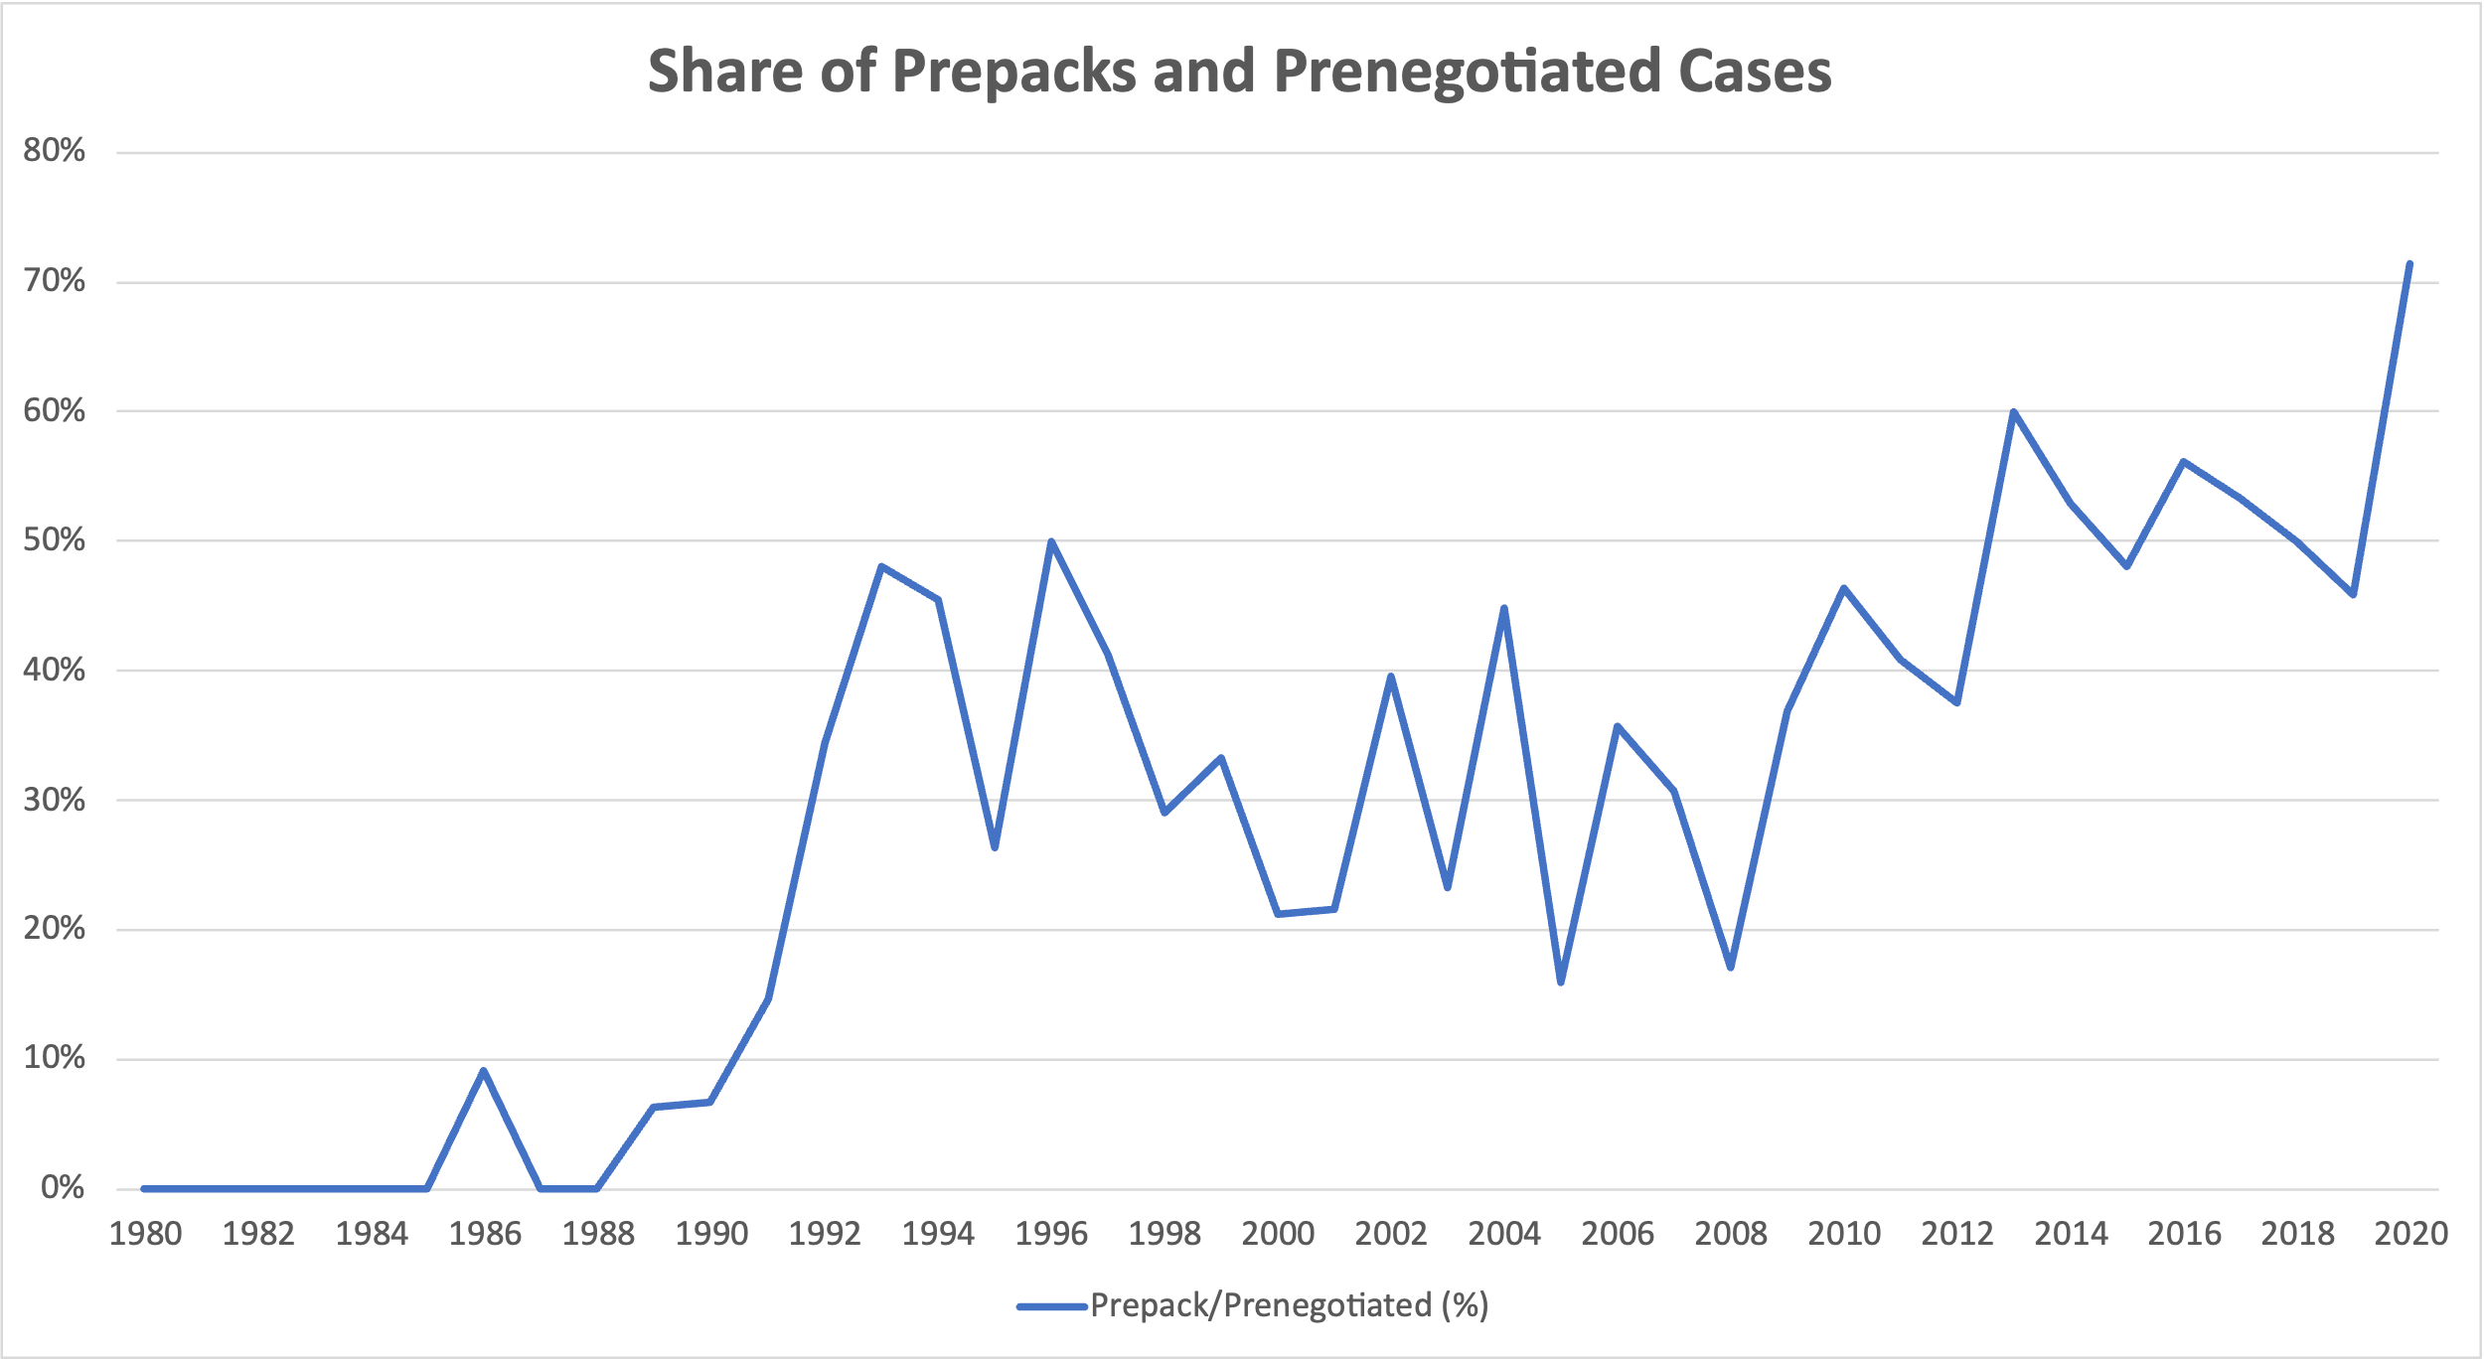
Prepacks Among Large Firms (>$100M in assets, 1980 dollars)

Slide 19
Case Length is Falling

Slide 20
363 Sales Can be a Substitute for Reorganization

Slide 21
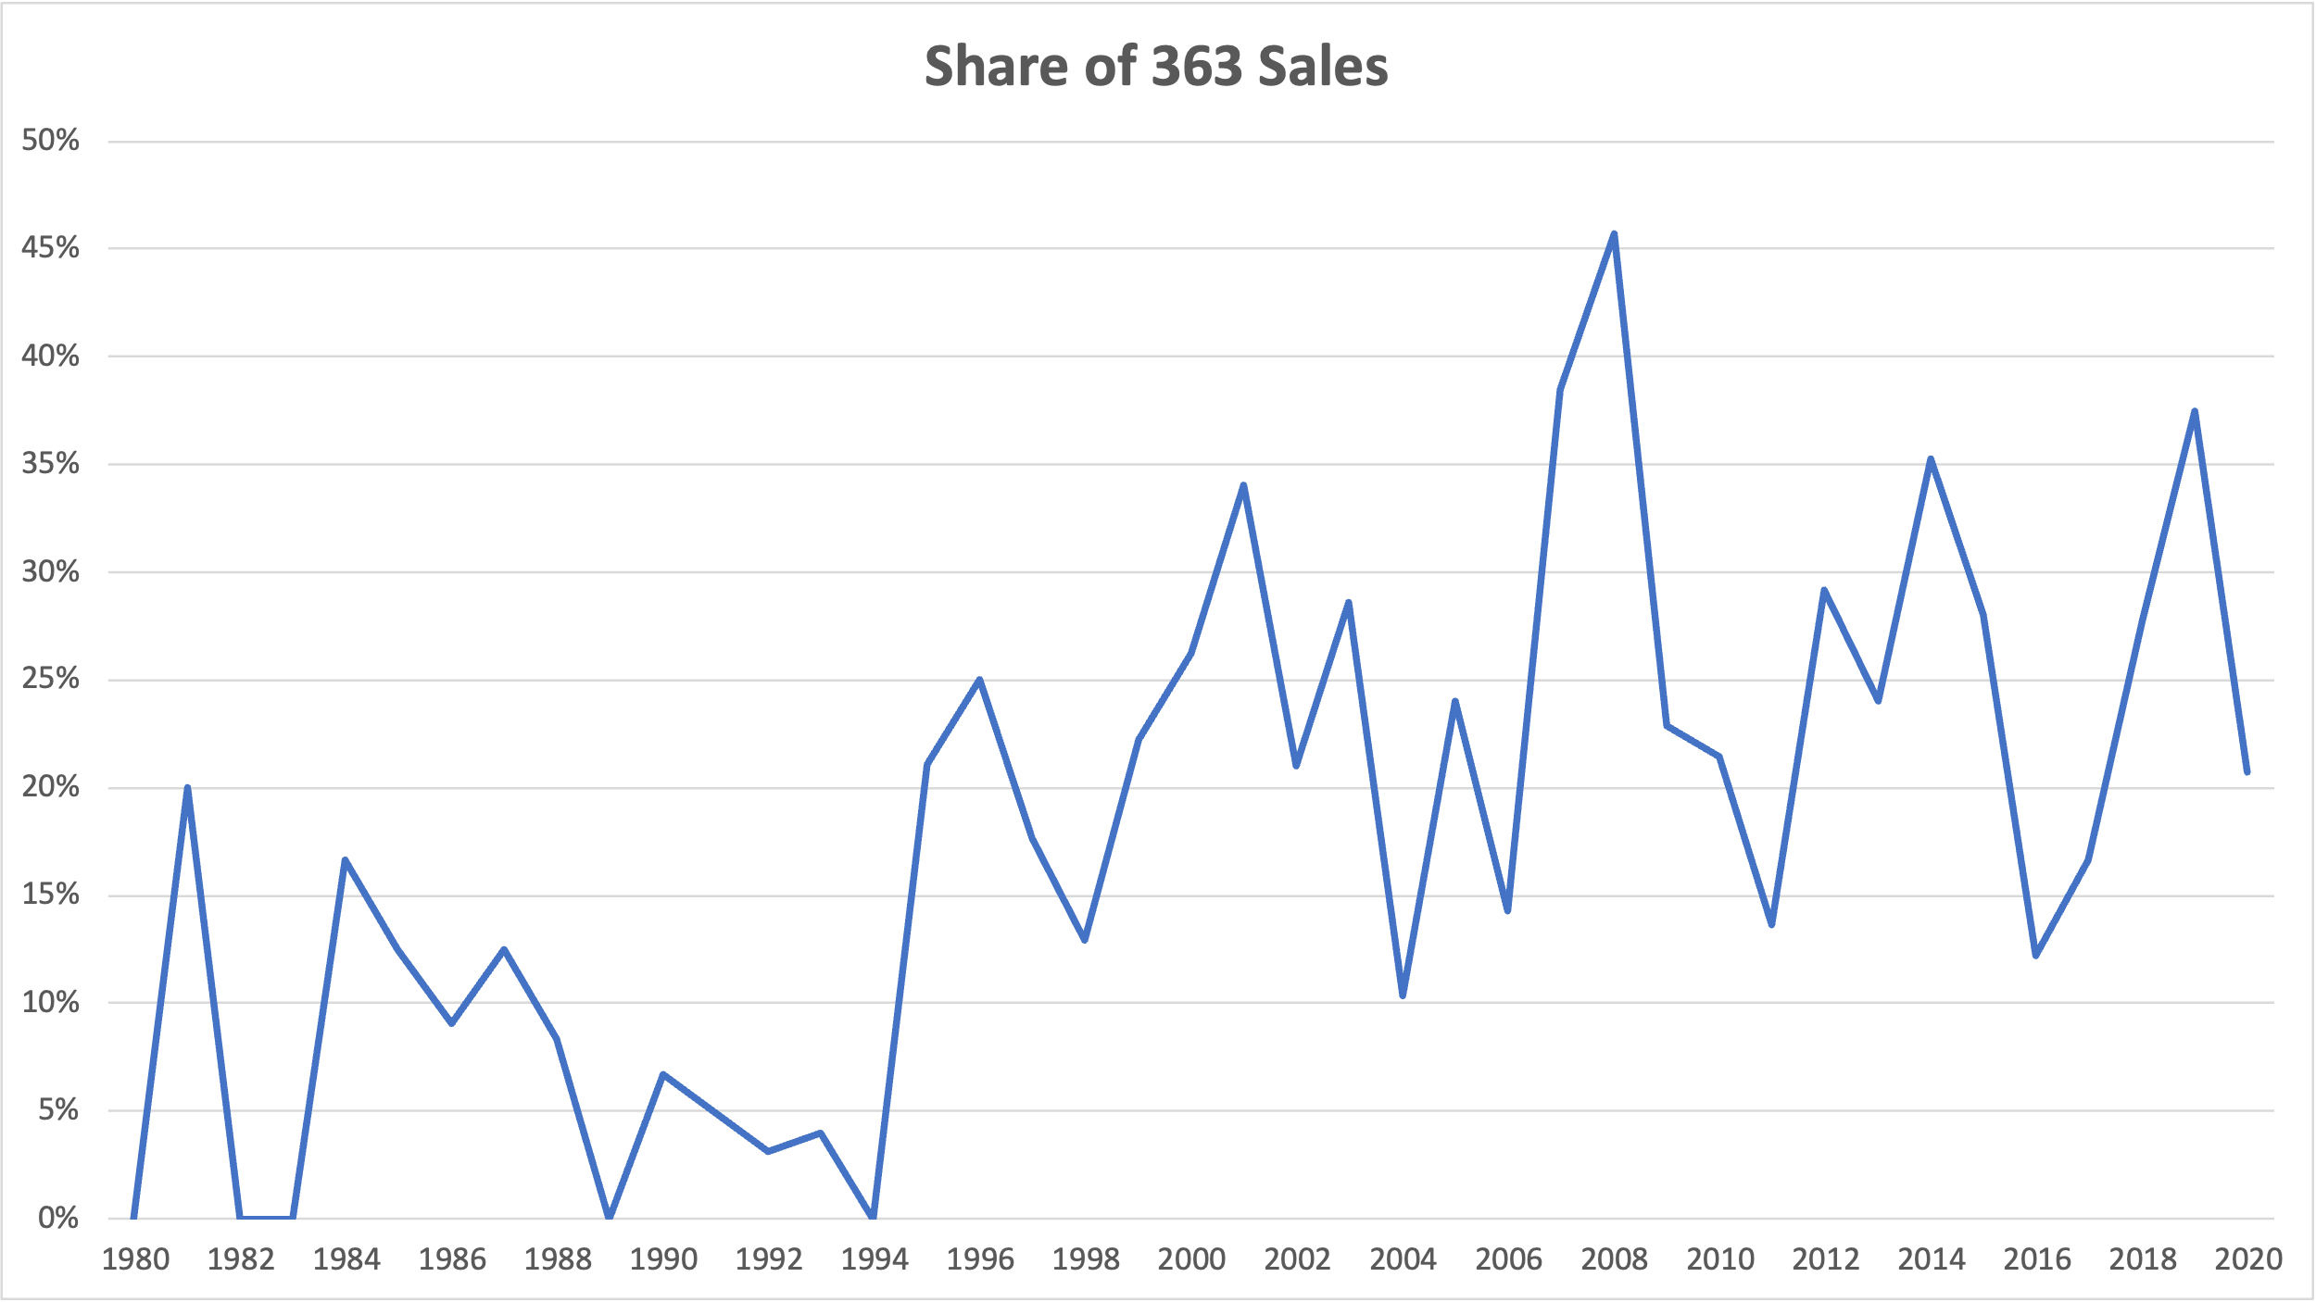
20-30% of Large Chapter 11s Involve Sale of Entire Firm

Slide 22
Creditor Control Through DIP Financing

Slide 23
DIP Financing: DIP Orders
  A debtor typically files a motion requesting court-approval of DIP financing as a part of its “first-day” motions. Notice is sent to parties in interest, who are given an opportunity to object.
  DIP motion initially requests emergency “interim” approval from the bankruptcy court to borrow amounts necessary to avoid immediate and irreparable harm to the debtor’s estate pending the final DIP hearing.
    This authority to allow for the immediate funding of a portion of the DIP loan is on an interim basis.
    The interim amount is sized to bridge the debtor’s liquidity to a final DIP hearing.
    DIP lender protections in an interim order are less extensive than in the final DIP order.
  At both the interim and final DIP hearings, to satisfy the applicable standards for obtaining DIP financing, a debtor will present evidence it could not have obtained credit on more favorable terms.
    The company’s banker typically provides an affidavit/testifies at the DIP hearing (if called to do so).
  A final DIP order can be entered as soon as 15 days and as late as 60 days (in highly contested cases) after entry of an interim DIP order.
    Some lenders require the full amount of a delayed-draw term loan to be funded upon entry of the final DIP order (into a controlled account), but then will allow the debtor to access only upon satisfaction of certain conditions.
  DIP orders typically provide that liens granted as part of the DIP financing, including liens on a debtor’s real and personal property, receivables, and other unencumbered assets, are perfected automatically, without the need to file a financing statement or comply with other requirements that might be applicable outside of bankruptcy.

Slide 24
Postpetition Borrowing (“DIP Financing”)
Credit
Secured by
Priming Lien
If unable to
obtain credit without
priming lien
Credit with
Superpriority Status,
Secured by Lien on
Unencumbered Property, or
Secured by Junior Lien on Property
Subject to Existing Lien
If unable to
obtain unsecured
credit
Unsecured Credit Allowable
as an Administrative Expense
If outside ordinary course of business & after notice & hearing
Without Notice and Hearing, Trustee
May Obtain Unsecured Credit in Ordinary Course of Business

Slide 25
DIP Financing: Milestones
DIP Financing Milestones (Generally)
  Although less common and/or less comprehensive in a prepackaged chapter 11 case, DIP lenders may use DIP milestones as a monitoring device in the chapter 11 case.
    However, sometimes milestones are used by DIP lenders as a means to take a controlling role in chapter 11 cases.
  Failure to satisfy a milestone (collectively, the “Milestones”) will often constitute an “Event of Default.”
    Timing of Milestones can be the subject of heavy negotiations.
Sample Milestones
  On or before [___], the Bankruptcy Court shall have entered the Final DIP Order, in form and substance acceptable to the DIP Agent and the DIP lenders.
  On or before [___], the Debtors shall have filed a plan of reorganization accompanied by a disclosure statement, in each case in form and substance acceptable to the DIP Agent and the DIP lenders.
  On or before [___], the Bankruptcy Court shall have entered an order, in form and substance acceptable to the DIP Agent and the DIP lenders, confirming the Plan.
  On or before [___], the effective date of the Plan shall have occurred.

Slide 26
Summary

Slide 27
Types of U.S. Restructurings
Out-of-Court |  | Avoids in-court restructuring Cannot bind creditors absent contractual “drag” rights or consent, which may present challenges for transactions that require unanimous consent such as amending “sacred rights,” exchanging debt for equity, and giving new debt in an exchange
Prepackaged Chapter 11 |  | Negotiate restructuring agreement (lock-up) with key threshold of constituents Prepare chapter 11 plan and disclosure statement Solicit votes on plan before commencing in-court restructuring File chapter 11 petitions and plan on first day Mainly for balance sheet restructuring only (no operational fixes) Generally does not impair trade creditors and litigation claimants
Prearranged Chapter 11 |  | Similar to a prepack, but file plan and disclosure statement early in case and solicit votes post-filing Provides opportunity for operational fixes (e.g., rejection of contracts and/or leases) Can impair trade creditors
Traditional Chapter 11 |  | File petition without deal with creditors Fix operations and maximize value with in-court restructuring powers Develop plan (often through negotiations with key creditors and/or official committee of unsecured creditors (if appointed)) during chapter 11 case

